Slide 1

Bombing campus Game

Slide 2
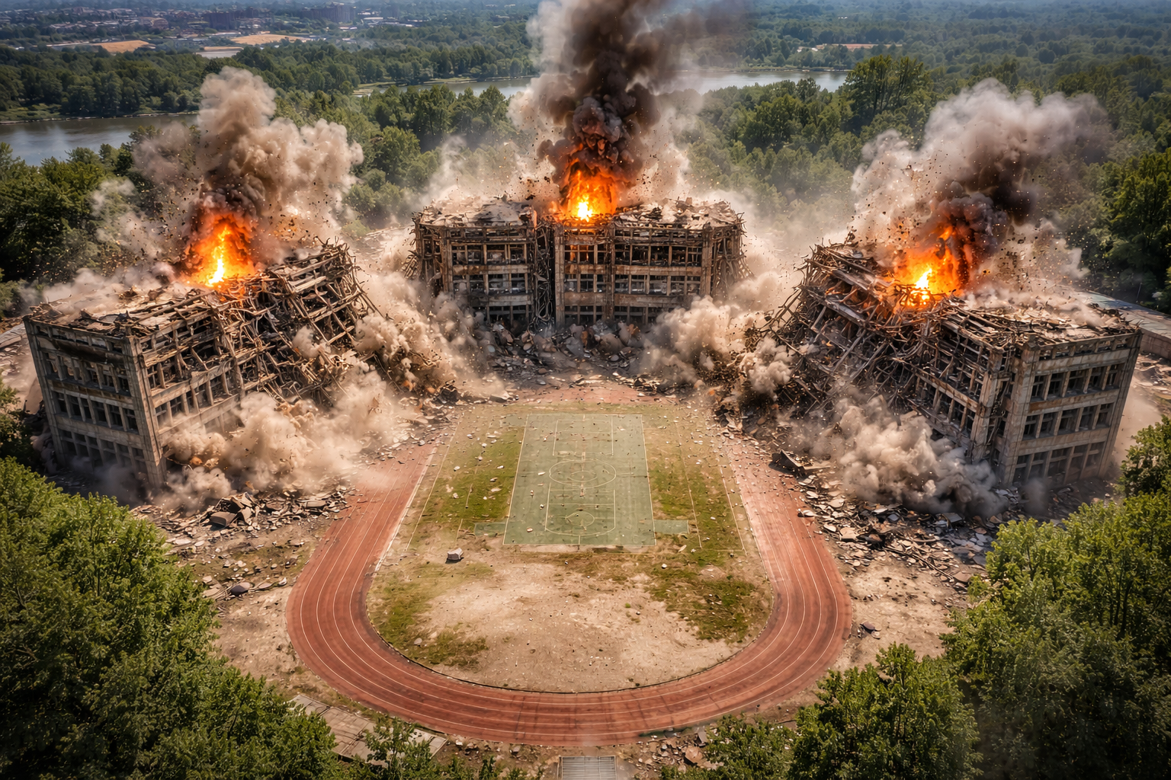

Slide 3
Demolition Engineer: terrible campus
Primary Objective (Per Level)
The player must:
Simultaneously demolish three U-shaped factory buildings
Collapse all structures inward toward the central courtyard
Avoid damage to surrounding roads, greenery, and nearby structures

Slide 4
Basic Win Conditions (Pass and Fail)
Level Completion Requirements
All three buildings fully collapse
No building falls outward
No uncontrolled chain explosions
Explosives used stay within budget
Failure Conditions
Any building remains standing
Structural collapse damages external areas
Explosion sequence goes out of control
Explosives budget exceeded

Slide 5
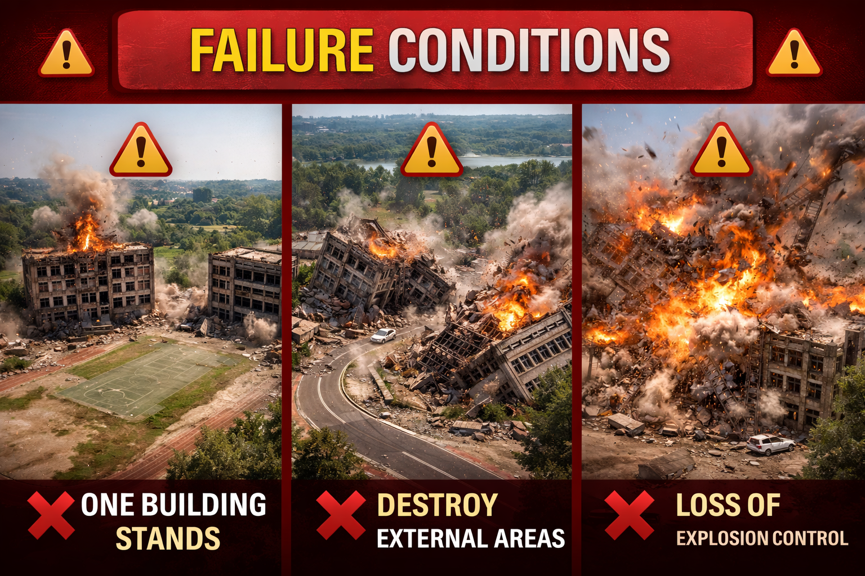

Slide 6
Scoring
Category | Description | Weight
Synchronization | Timing difference between explosions | ⭐⭐⭐⭐
Direction Control | Accuracy of inward collapse | ⭐⭐⭐⭐
Resource Efficiency | Amount of explosives used | ⭐⭐⭐
Debris Control | Debris spread radius | ⭐⭐⭐
Stability | Structural predictability | ⭐⭐

Slide 7
Challenge
Achievements
Master Engineer
Complete the demolition using the minimum possible explosives
Perfect Timing
Explosion time deviation less than 0.1 seconds
Green Demolition
Dust and debris spread below 20% of allowed radius
Structural Analyst
Achieve full collapse by destroying only load-bearing elements

