Slide 1
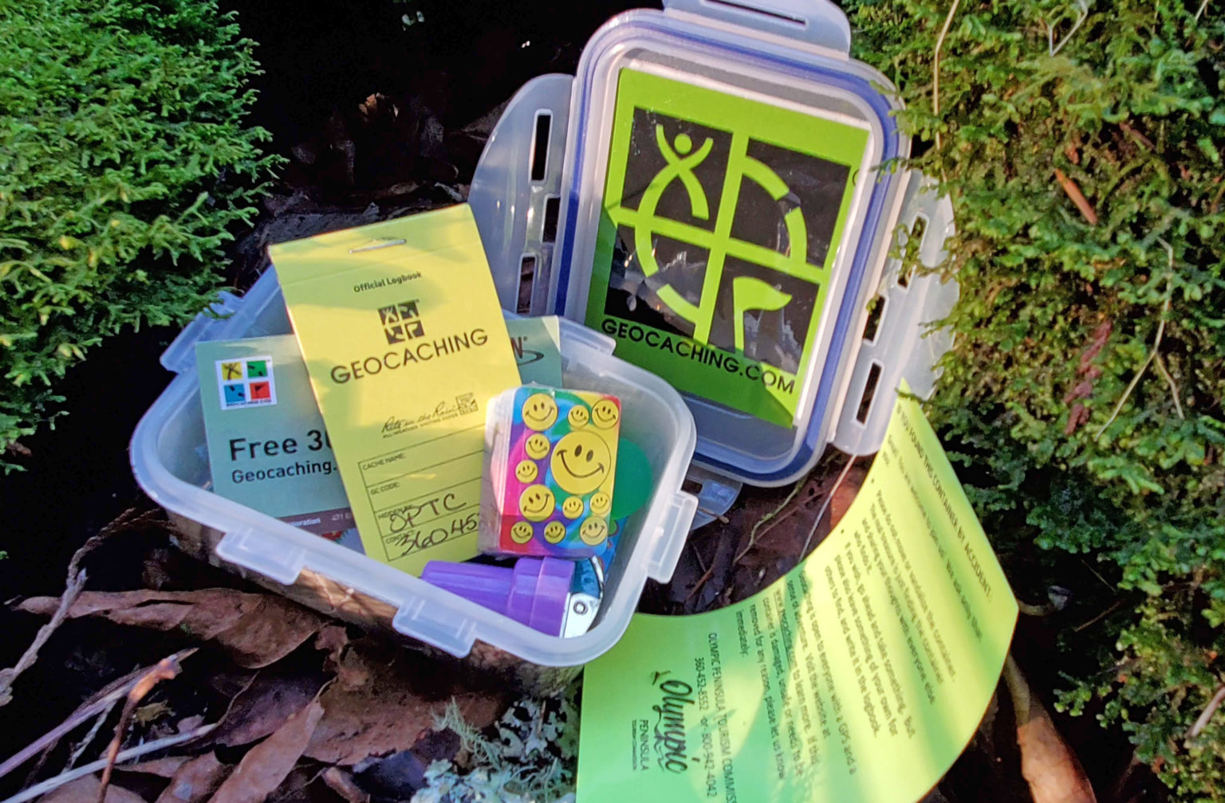
GeoCaching

Slide 2
What GeoCaching
Geocaching is a real-world, outdoor treasure hunting game that uses GPS-enabled devices.
Participants use geographic coordinates to search for hidden containers, called “geocaches,” which are placed by other players around the world.
A typical geocache contains a logbook for finders to sign, and sometimes small items or trackable objects.
Geocaching encourages exploration, outdoor activity, and adventure, and it can be enjoyed by people of all ages.

Slide 3

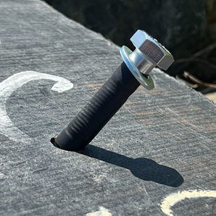


Geo
Caching
/ˈdʒiːoʊˌ keɪʃɪŋ/
Geo-
Comes from the Greek word gē (γῆ), meaning “earth” or “land”.
It is commonly used in words related to geography, such as geography and geology.
Caching
Comes from the word “cache”, meaning a hidden storage or secret stash.
In computing, a cache is temporary stored data; in Geocaching, it refers to a hidden container.
Containers

Slide 4

The Origin of Geocaching
Geocaching began in the year 2000 shortly after the the great blue switch* controlling selective availability was pressed United States government made GPS (Global Positioning System) signals available for civilian use with full accuracy.
May 3, 2000:
The first documented “GPS stash hunt” took place when Dave Ulmer from Oregon, USA, hid a container in the woods and posted its coordinates online.
This container included a logbook and some items to trade.
The idea quickly caught on, and soon an online community of geocachers emerged to share coordinates, experiences, and hints.
Evolution:
Over time, geocaching expanded globally, with millions of caches hidden worldwide, turning it into a popular outdoor recreational activity that combines technology, exploration, and adventure.
N 45° 17.460′ W 122° 24.800′
*there is no actual blue switch

Slide 5
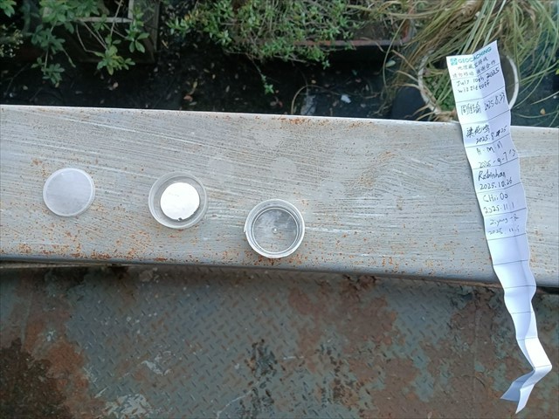

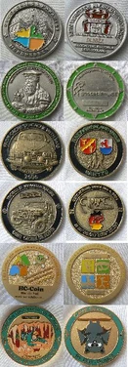

What inside cache?
Optional trade items
Small toys, badges, keychains, souvenirs, Trackables
Rule: “Take something, leave something of equal or greater value”
Essential items
Trackables
LogBook
to sign and record your visit
Container
*A cache I recently visited
GCB99QZ

Slide 6
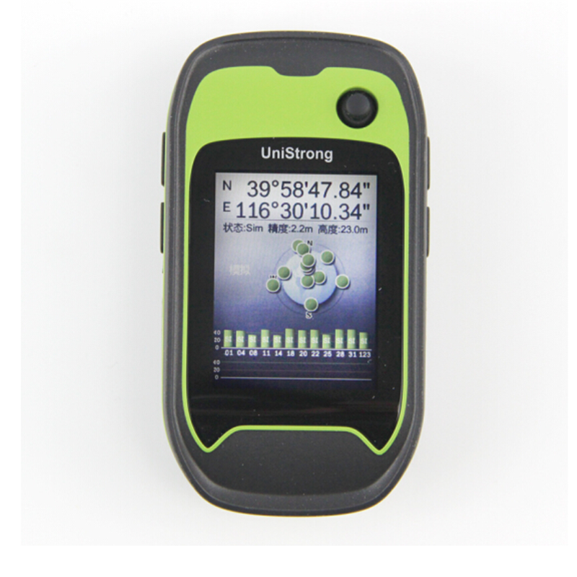


How to Participate in Geocaching
Steps:
Register an account
  On Geocaching.com or similar sites
Find Cache coordinates
  Search for caches near you on the website or app
Navigate to the Cache
  Use GPS, smartphone maps, or compass
  Stay safe; avoid private property or dangerous areas
Locate the Cache
  Observe surroundings and follow clues
Sign the log & trade items
  Sign the logbook with your name and date
  Optional: trade items according to the “take & leave” or “NTLN”
Share your experience
  Upload logs, photos, or notes on the website/app

Slide 7
What is CITO?
CITO = Cache In Trash Out
An environmental initiative started by the Geocaching community.
Participants collect trash and improve natural areas while searching for caches.
Encourages responsible geocaching and environmental stewardship.
CITO Principles
Leave no trace: Don’t leave trash behind
Safety first: Watch out for hazards while cleaning
Respect property: Only pick up litter in public or permitted areas
Have fun: Turn cleanup into a social and rewarding activity

Slide 8
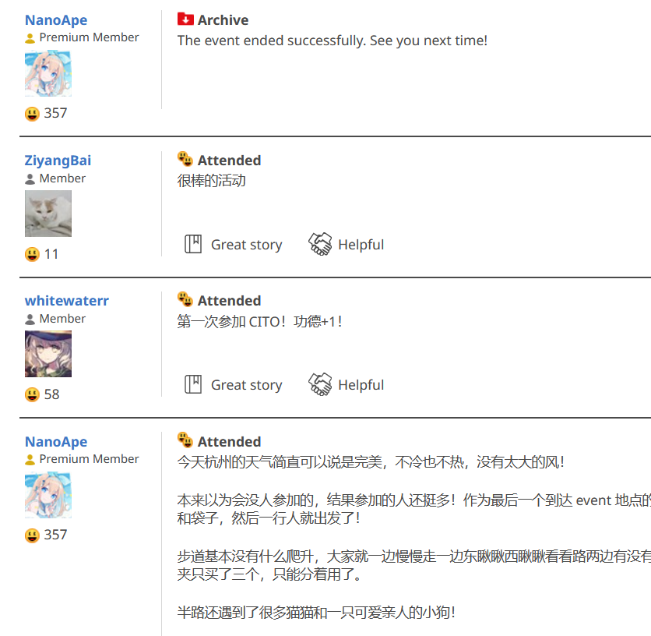

Slide 9
Significance of Geocaching
Outdoor exploration: encourages discovering nature and hidden urban spots
Community: join a global community to share finds and experiences
Educational value: develop navigation, observation, and patience
Fun & challenge: a treasure hunt game that promotes exercise and enjoyment
Environmental awareness: follow Leave No Trace principles

